Slide 1
Reporting Pre-Kindergarten Student Data
Jeff Bittner
NERIC - Program Coordinator II – Data Warehouse State Reporting

Slide 2
Agenda
How to Report Pre-K Students
What Reports are Reviewed?
How to Report Pre-K Teachers
When is Data Reported?

Slide 3
Background
All pre-kindergarten children must be reported through Level0 to NYSED using three templates:
Demographics
Enrollment
Program Facts
Students are in grade PKH (half day) or PKF ( full day).

Slide 4
The Four Questions of Pre-K Reporting If you can answer these, you can report your students correctly.
Is it a full day or half day program?
Where does the funding for the placement come from?
Is the placement funded by the Allocational Universal Pre-K (UPK) grant in any way?
Who is operating the program?
Is it district operated or operated by another eligible agency under contract with the district (for example Community Based Organization, BOCES, Head Start, or Day Care)?
Is the student General Ed or Special Ed?
Special Education students will also have a 5786- “Preschool Student with a Disability” Program Service code.

Slide 5
Questions regarding any of the prekindergarten grant programs may be directed to the Office of Early Learning at oel@nysed.gov

Slide 8
The Four Questions of Pre-K Reporting If you can answer these, you can report your students correctly
Is it a full day or half day program?
Where does the funding for the placement come from?
Is the placement funded by the Allocational Universal Pre-K (UPK) grant in any way?
Who is operating the program?
Is it district operated or by another eligible agency under contract with the district (Community Based Organization)?
Is the student General Ed or Special Ed?
Special Education students will also have a 5786- “Preschool Student with a Disability” Program Service code.

Slide 9
Level 0 Locations and Start Dates
Locations and start dates are very important when reporting Pre-K students.
“0666” on the guide is referring to the location on your Level0 tied to the BEDS code starting with the first 8 digits of your BEDS code ending in 0666. The location code(s) on L0 could be anything.
The “0666” location code is used anytime a program is operated by an agency under contract with the district or a Community Based Organization.
This goes for UPK and “Other” Pre-Kindergarten programs.
The begin dates of the enrollment in PKH or PKF grade must match the begin date of the 902- UPK or 990- Other Pre-K program code.

Slide 10
UPK Students Enrollment and Programs

Slide 11
How to Report 902 - UPK Students
Enrollment
Entry Code: 0011 – Enrollment in building or grade
Enrollment Location: Refer to SIRS manual or cheat sheet referred to earlier.
If District Operated UPK, use Building BEDS Code.
If contracted by the District, use 0666 location.

Slide 12
From SIRS Manual: “Table of Reporting Responsibility for Preschool-Age and Prekindergarten Students.”
Starting on page 27 (V14.3).
District Operated UPK
BOCES Operated UPK
Any “not-district” Operated UPK

Slide 14
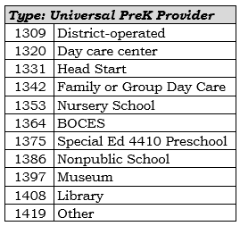
How to Report 902 - UPK Students
Enrollment
Entry Code: 0011 – Enrollment in building or grade
Enrollment Location: Refer to SIRS manual or cheat sheet
If District Operated UPK, use Building BEDS Code.
If contracted by the District, use 0666 location.
Grade: PKH or PKF
If student has been withdrawn from school by a parent/guardian use Exit Code 425: Left school, no documentation of transfer.
Programs Services
Pre-K Program Code: 902- Universal Pre-K Program
Universial Pre-K Provider
Enrolled at Building of Attendance
Enrolled at 0666 LOCATION

Slide 15
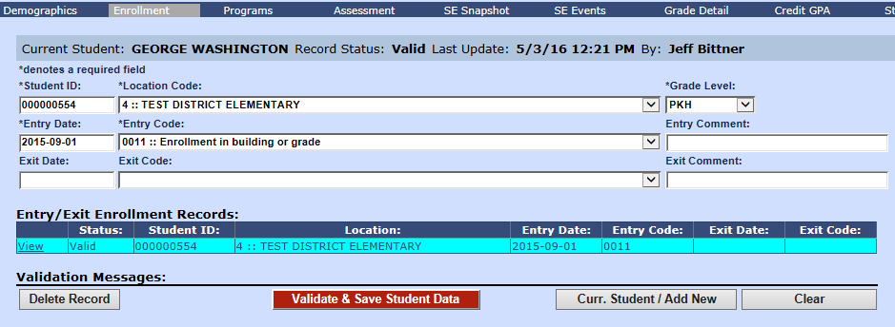
District Operated UPK on L0 - Enrollment

Slide 16
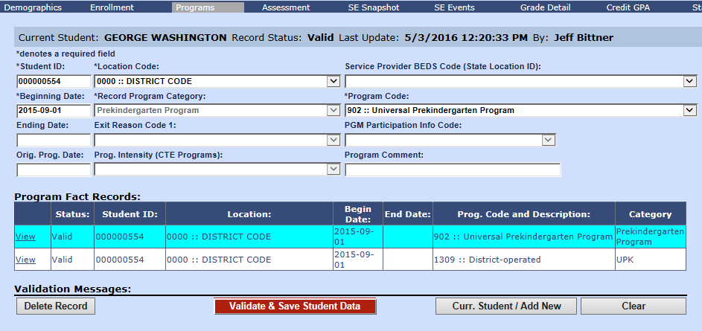
District Operated UPK on L0 - Programs

Slide 17
District Operated UPK on L0 - Programs

Slide 18
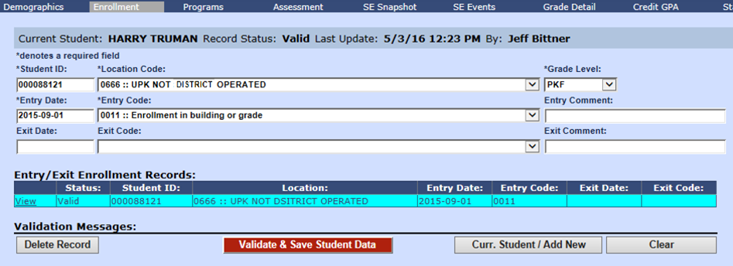
Not District Operated UPK on L0 - Enrollment

Slide 19
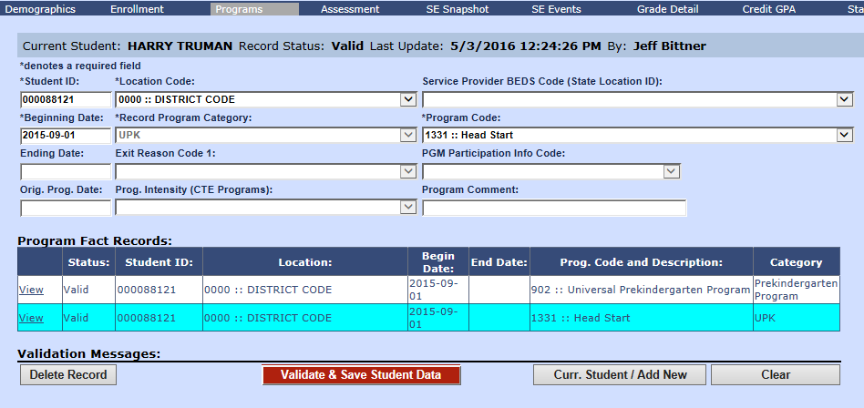
Not District Operated UPK on L0 - Programs

Slide 20
Other Pre-K Students Enrollment and Programs

Slide 21
How to Report 990 - Other Pre-K Students
Enrollment
Entry Code: 0011 – Enrollment in building or grade
Enrollment Location: Refer to SIRS manual or cheat sheet
If District operated PK, use Building BEDS Code.
If BOCES operated PK, use BOCES BEDS Code (not building)
If operated by a Community Based Organization, use 0666 location

Slide 22
From SIRS Manual: “Table of Reporting Responsibility for Preschool-Age and Prekindergarten Students.”
Starting on page 29.
District Operated Other Pre-K
BOCES Operated Other Pre-K
Along with the wording on page 63 of the SIRS Manual:

Slide 24
How to Report 990 - Other Pre-K Students
Enrollment
Entry Code: 0011 – Enrollment in building or grade
Enrollment Location: Refer to SIRS manual or cheat sheet
If District operated PK, use Building BEDS Code.
If BOCES operated PK, use BOCES BEDS Code (not building)
If operated by a Community Based Organization, use 0666 location
Grade: PKH or PKF
If student has been withdrawn from school by a parent/guardian use Exit Code 425: Left school, no documentation of transfer.
Programs Services
Pre-K Program Code: 990 - “Other” Pre-K Program
Do not enter Universial Pre-K Provider

Slide 25
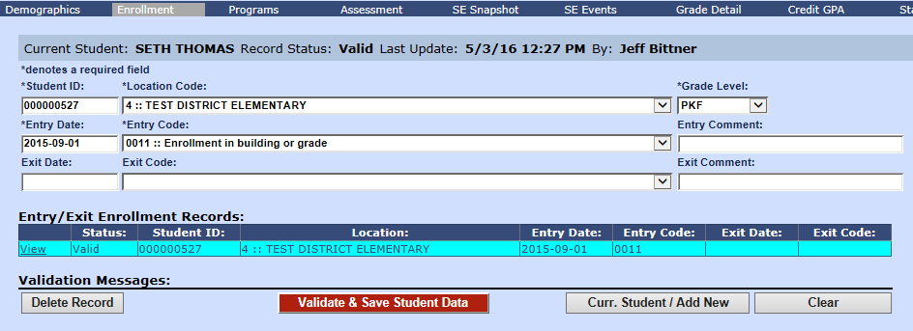
District Operated PK on L0 - Enrollment

Slide 26
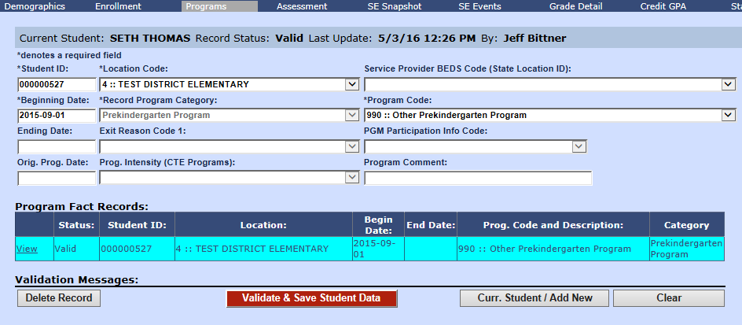
District Operated PK on L0 - Programs

Slide 27
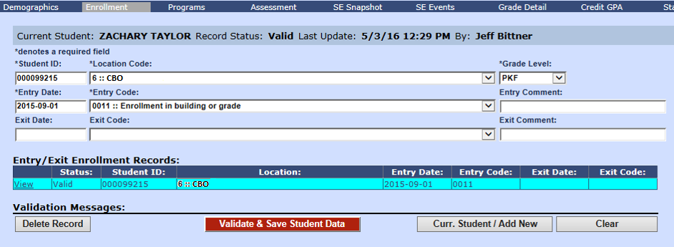
Not District Operated PK on L0 - Enrollment

Slide 28
Not District Operated PK on L0 - Programs

Slide 29
Operated by another District

Slide 30
UPK or PK Program Operated by another District
Only report records for resident students with a disability or those referred to the CPSE for determination of eligibility for special-education services.
Enrollment
Entry Code: 5905 – CSE or CPSE responsibility only
Enrollment Location:
Building BEDS Code of attendance.
Grade: PS
Programs Services
5786- “Preschool Student with a Disability” (If a PS student with a disability or…if after determination phase, found eligible)
If student is declassified or parent revoke consent for special-education services, use code 901 - “Declassified” to end 5786 code.
Do not report Pre-K code (district they are attending will report Pre-K codes)

Slide 31
From SIRS Manual: “Table of Reporting Responsibility for Preschool-Age and Prekindergarten Students.”
Starting on page 27.
Pre-K operated by another District

Slide 33
Pre-K Student with a Disability

Slide 34
Reporting Pre-K Students with a Disability
In addition to Pre-K Program codes, report code 5786- “Preschool Student with a Disability”.
Remember CPSE students are always grade PS over the summer (7-1 to 8-31).

Slide 35
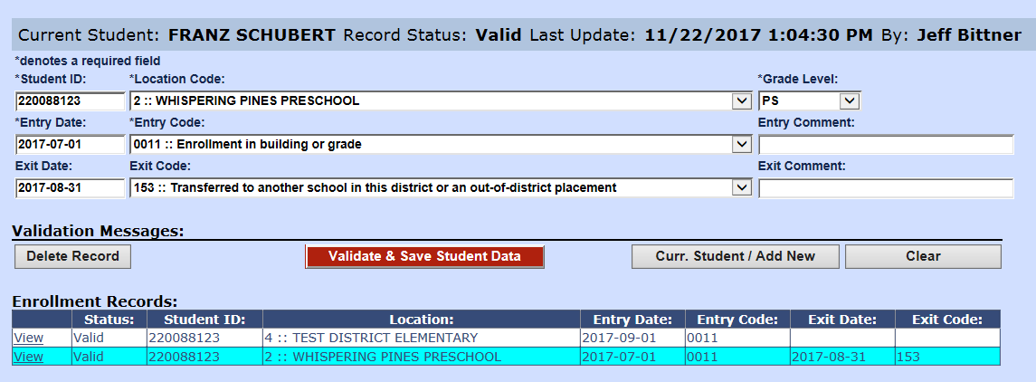
Reporting Pre-K Students with Disabilities Enrollment
The summer grade PS record indicates the student is a Pre-School student with a disability.

Slide 36
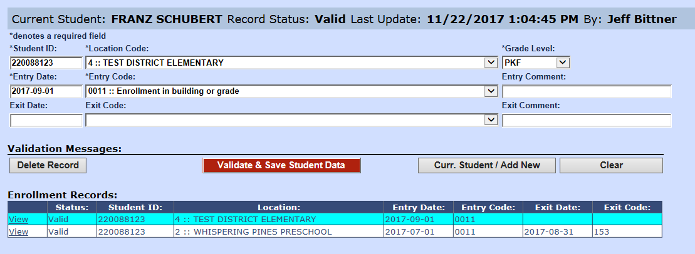
Reporting Pre-K Students with Disabilities Enrollment
The summer grade PS record indicates the student is a Pre-School student with a disability.

Slide 37
Reporting Pre-K Students with Disabilities Programs
In this example, the student came into the school year already determined as a Pre-School student with a disability.

Slide 38
Pre-K students and the Determination Phase
A Student already enrolled in Pre-K does not get a 4034 - Preschool-age students enrolled solely for determining eligibility for special education services entry code.
If they are determined eligible, start a 5786 - Preschool Student with a Disability program service code on the day they start services.
They continue to be enrolled at their Pre-K program according to the rules we’ve covered.

Slide 39
Pre-K Student Templates

Slide 40
Pre-K Student Templates
REPORT these Templates for Pre-K
Templates for CPSE Pre-K students only
Demographics
Enrollment
Programs
Student Class Entry Exit (for district operated programs only)
S.E. Snapshot – BEDS Day (all enrolled on BEDS Day) and/or End Of Year (all who received CPSE services this school year).
Assessment – COSFs – only for districts with Federal Indicator 7 (VR-15) for students who received CPSE for at least six months and left CPSE sometime this school year. Federal Indicator Schedule
S.E. Events – only if they went through determination this school year. (Check your districts required Federal Indicator for current year)
DO NOT report these Templates for Pre-K
Staff Student Course
Student Daily Attendance
Student Class Grade Detail
Student Class Entry Exit/Course Instructor Assignment (for all programs other than district run)

Slide 41
Pre-K Students on Level2 Reports

Slide 42
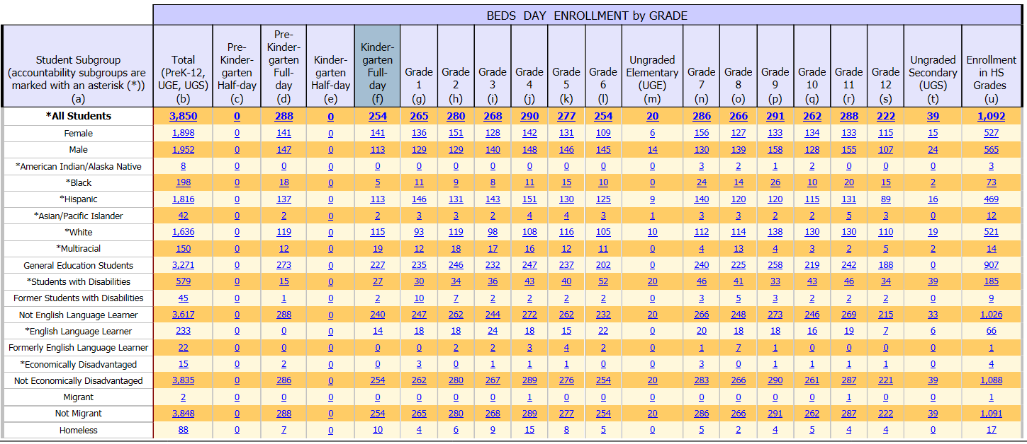
SIRS-313 BEDS Day Enrollment by Location of Enrollment & Student Subgroup
These are students enrolled on BEDS Day at locations within your district.

Slide 43
SIRS-314 BEDS Day Enrollment Verification Report by District of Residence
Counts of students enrolled on BEDS Day by grade and by their District of Residence.

Slide 44
SIRS-316 BEDS Day Enrollment Verification Report for District Pre-K
Counts of Pre-K students enrolled on BEDS Day.
Reported with the 902 UPK Code
Missing UPK Setting Code
Reported with 990 “Other” Pre-K code

Slide 45
SIRS-323 Free and Reduced Price Lunch Eligible Students Enrolled on BEDS Day

Slide 46
SIRS-401 Reasonableness Report
Counts of students in UPK and Other Pre-K programs as well as UPK Providers at anytime during the school year. Compares data between last year and this year.

Slide 47
Pre-K Teachers

Slide 48
Pre-K Teacher Templates
Your Pre-K Teachers instructing your students in your building
Itinerant Pre-K Teachers (those employed by another District or BOCES and are instructing your students in your program at your building)
Staff Snapshot with Itinerant = N
Staff Attendance
Course Instructor Assignment
Staff Snapshot with Itinerant = Y
Course Instructor Assignment
Pre-K Teachers NOT in your building
Do NOT Report these teachers.
Note: Pre-K Teachers are not subject to APPR, therefore they have no Staff Evaluation reported.

Slide 49
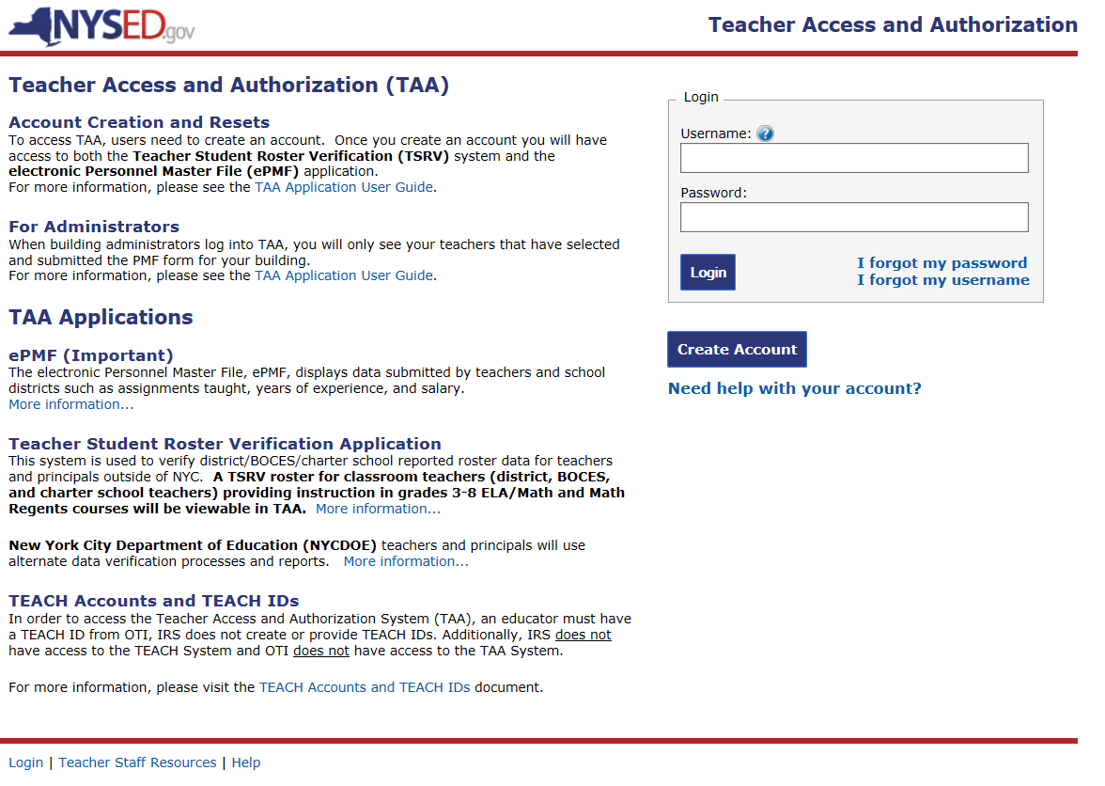
Pre-K Teachers on ePMF
https://eservices.nysed.gov/taa/
Pre-K Teachers (including itinerants) who teach your students in your building(s) are expected to fill out the Teaching Assignment on the TAA ePMF.
They would use the Common Branch: 2412 - Pre-Kindergarten code
ePMF on the TAA opened on October 3rd 2018.
A Teachers can’t access the TAA until their Staff Snapshot record has been reported to Level2.
The TAA will be open for Teachers to enter data until December 14th 2018.

Slide 50
Pre-K Reporting Timeline and References

Slide 51
Pre-K Reporting Timeline
September/October – Report Demographics, Enrollment, and Pre-K Program Services. Continue reporting regularly throughout the school year.
September/October – Report Staff Snapshot, Course, Location Marking Period, and Course Instructor Assignment, and Student Class Entry exit as applicable. Continue reporting regularly throughout the school year.
October/November– District Staff should be reviewing the BEDS day reports and making changes and updates as needed in source system and reporting corrected data.
October/November – Report BEDs Day Snapshot. Data appears on PD system VR reports which must be certified by January 7th 2019.
January 4th 2019 – First BEDS Day data pull. Counts of UPK students are collected for the purpose of calculating UPK grant funding as well as eligibility for mid-year expansion funding. Pre-K data should be reviewed and correct on L2 prior to this date.
March 22nd 2019 – Second BEDS Day data pull. Pre-K data should be reviewed and correct on L2 prior to this date.
July – Report End Of Year Snapshot. Data appears on PD system VR-13 and must be certified by August 26th 2019.
Mid August – End Of Year reporting deadline. Pre-K data should be reviewed and correct on L2 prior to this deadline.

Slide 52
References
Latest SIRS Manual: http://www.p12.nysed.gov/irs/sirs/
NYSED UPK: http://www.p12.nysed.gov/upk/
NYSED Early Learning: http://www.p12.nysed.gov/earlylearning/
Federal Indicators: http://www.p12.nysed.gov/sedcar/sppschedule2011-2019.html
TAA Site: https://eservices.nysed.gov/taa/

